Slide 1
Triton for All
Triton as a Device-Independent Language
ian Bearman
Microsoft, AI Platform
Sept. 20, 2023

Slide 2
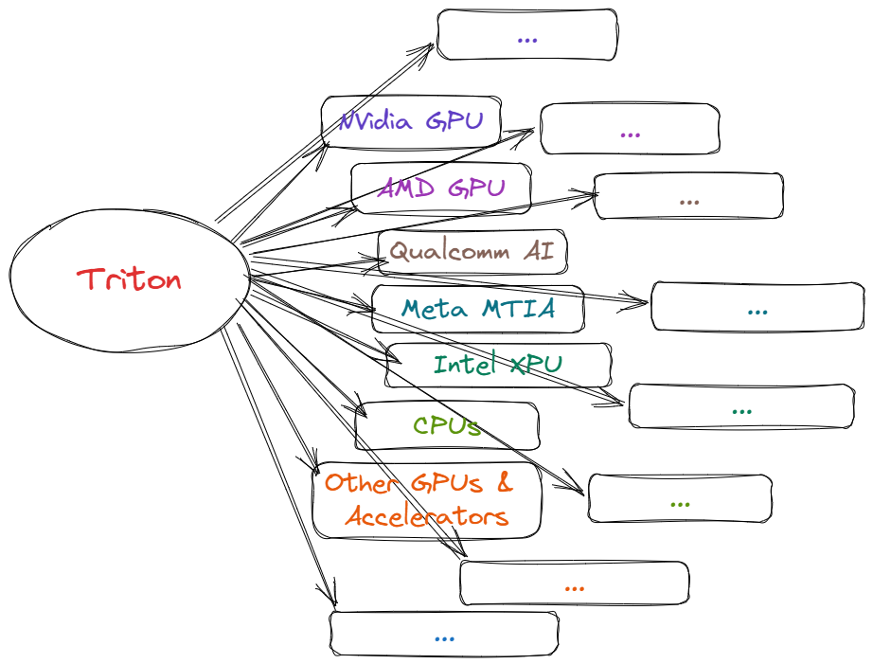
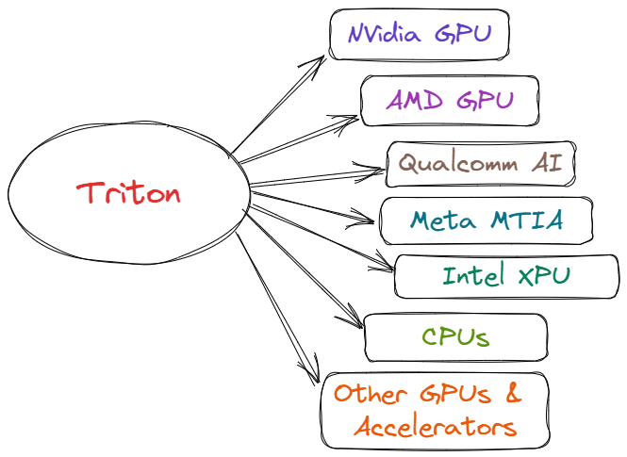
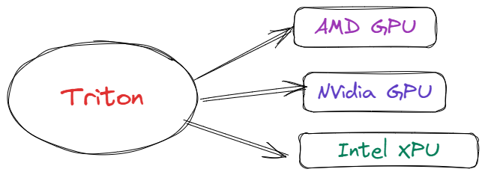
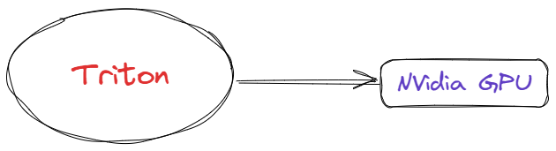

Triton for All
Notes:
Triton started off as a way to write high-performance CUDA. But we want to grow to support more back-ends. So how do we go from here [click] to here [click] and beyond [click]

Slide 3
Growing Triton
Build the back-ends
Plugin model
Define semantics: specification, conformance, validation
Evolve the language

Slide 4
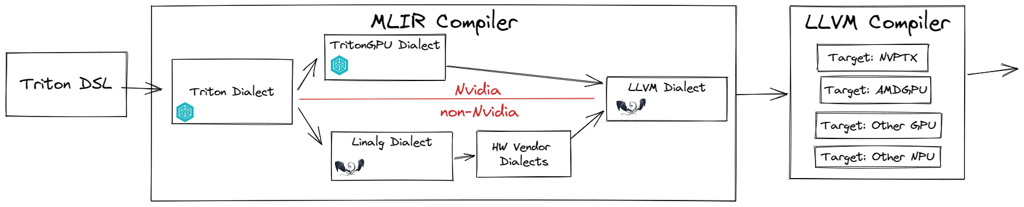
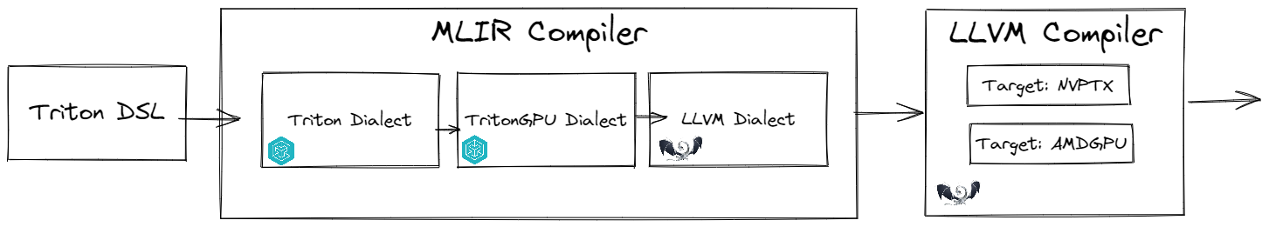
The Middle Layer
Not tied to a front-end, not tied to a back-end
A place to build shared analysis, transforms, and optimizations

Slide 5
Why a Shared Middle Layer
The need for a language-agnostic, HW agnostic layer
Why Hardware-Agnostic?
Share representation across hardware targets
Common analysis, optimizations and transformations
Why Language-Agnostic?
Folks want to bring existing MLIR back-ends
Compatible with other languages/graphs

Slide 6
Why linalg Dialect
Shared/common MLIR with active development
The value semantics of linalg match the BLOCK SIMD-style code of Triton operations
Linalg provides a powerful way to do further transformations and optimizations (e.g., loop fusion and tiling)
Built-in transformations that folks can use out-of-the-box or customize

Slide 7
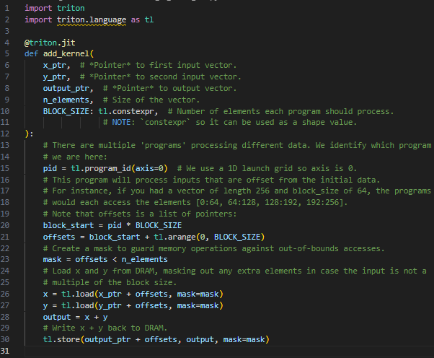
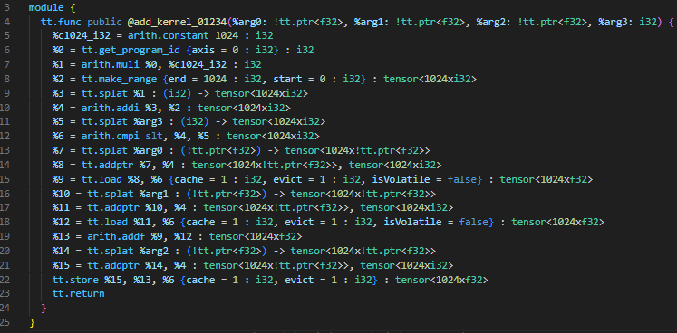
Triton to Triton-IR

Slide 8
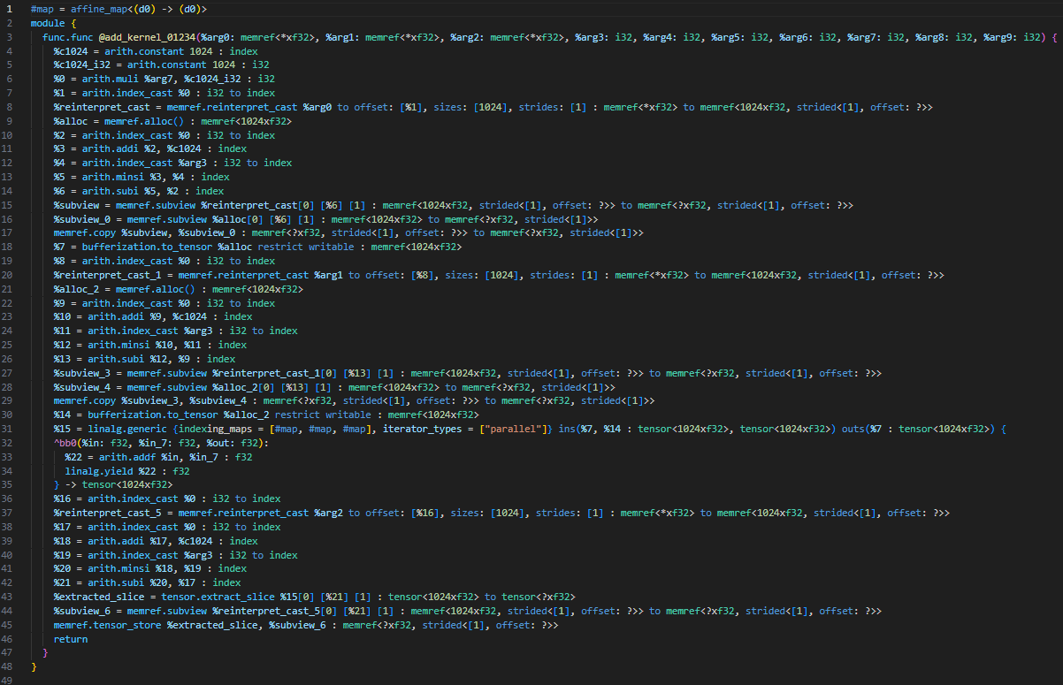
Triton-IR to linalg
Notes:
Triton IR -> Linalg IR (tensors) + support IR
Track triton pointers using Pointer Analysis
Identify size, stride, and other metadata
BlockPointer makes this a lot easier ☺
Map triton load/store as pointer conversion from memref to tensor. Use the Pointer Analysis to build appropriate cast + subview

Slide 9
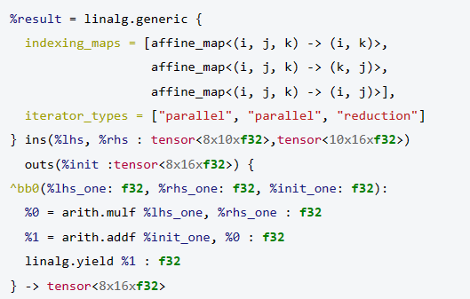
Linalg Generic
Notes:
This is a matmul

Slide 10
Getting Involved
https://github.com/openai/triton/pull/1797
https://github.com/openai/triton/discussions/1842
We’ll be publishing (soonish) a way for folks to build on this work
Consume and use in your project
Contributions
Code updated to Triton/main
Support for requested features: pointer-modulo, block-pointers
Other missing features

Slide 11
Q&A
Is Triton-to-Linalg raising the IR level?
No; the Triton tensor arithmetic basically maps 1:1 to linalg
Aren’t triton kernels already optimized by the author?
Yes, but the compiler needs to do more work
The triton compiler still has a lot of work to do to build an optimal mapping to HW
Are there operations that cannot be represented in linalg?
Yes, this happens (e.g., linear scan)
Linalg supports through interfaces: e.g., linalg_ext (IREE), TensorTM (torch-mlir)
Notes:
The same program should run well on future HW revisions (e.g., change in cache size, wider tensor core, etc.)
Ideally a program should run “well” on other HW (GPU vs. GPU, CPU vs. GPU, etc.)

Slide 13


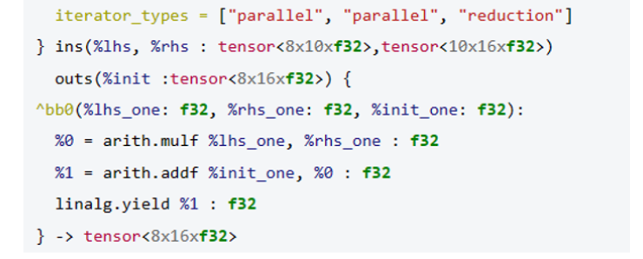
Linalg Generic – library call
Notes:
This is a matmul

Slide 14
Technical Deep Dive

Slide 15

Danger
☺ Detailed MLIR content coming ☺

Slide 16
Triton to Triton-IR

Slide 17
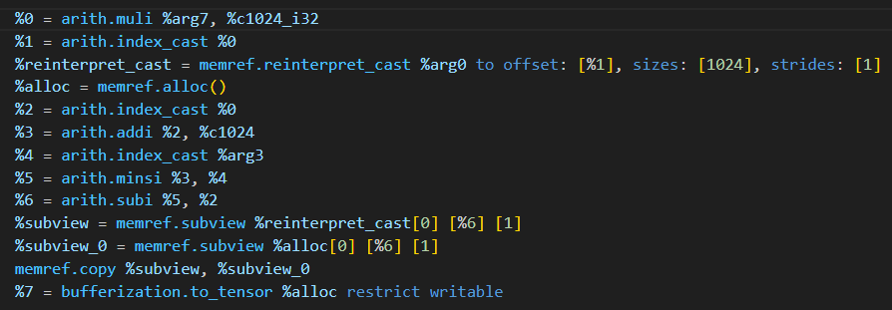
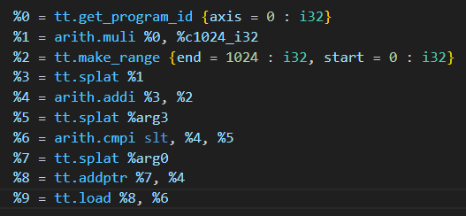
Triton-IR to linalg
Notes:
Triton IR -> Linalg IR (tensors) + support IR
Track triton pointers using Pointer Analysis
Identify size, stride, and other metadata
BlockPointer makes this a lot easier ☺
Map triton load/store as pointer conversion from memref to tensor. Use the Pointer Analysis to build appropriate cast + subview

Slide 18

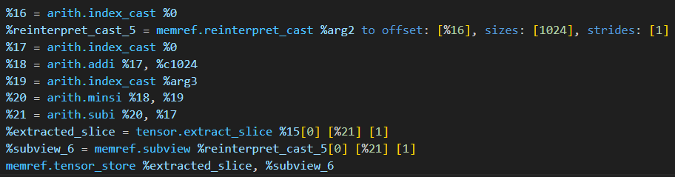
Triton-IR to linalg
Notes:
Triton IR -> Linalg IR (tensors) + support IR
Track triton pointers using Pointer Analysis
Identify size, stride, and other metadata
BlockPointer makes this a lot easier ☺
Map triton load/store as pointer conversion from memref to tensor. Use the Pointer Analysis to build appropriate cast + subview

Slide 19
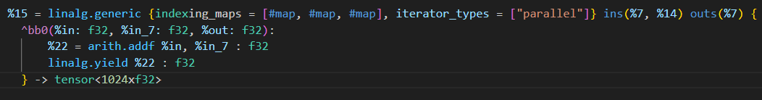

Triton-IR to linalg
Notes:
Triton IR -> Linalg IR (tensors) + support IR
Map triton operations on blocks to LinalgOp on tensors
E.g. add becomes linalg.generic { add }

Slide 20
Pointer & Mask Analysis
Converts array-of-pointers to pointer-to-array
This maps well for contiguous memory accesses (common case)
Coming soon: support for block-sparse access
TBD: Gather/Scatter support for true non-contiguous access
Detects contiguous mask and replaces it with bounds checks

Slide 21
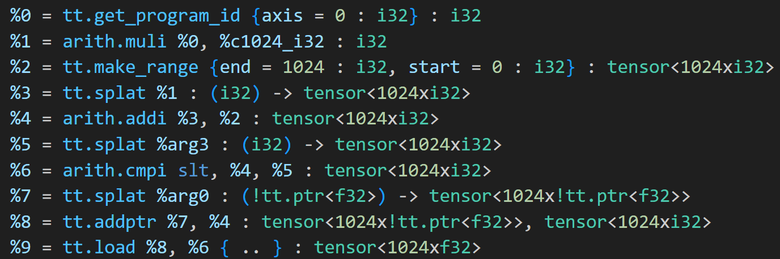
Pointer Analysis
%arg0
Base:
Offset:
Stride:
Length:
n/a
1024
Notes:
The actual code is a forward pass, but its easier to think about as a backwards pass

Slide 22
Pointer Analysis
%arg0
Base:
Offset:
Stride:
Length:
0
+
PID * 1024
n/a
1024
Notes:
The actual code is a forward pass, but its easier to think about as a backwards pass

Slide 23
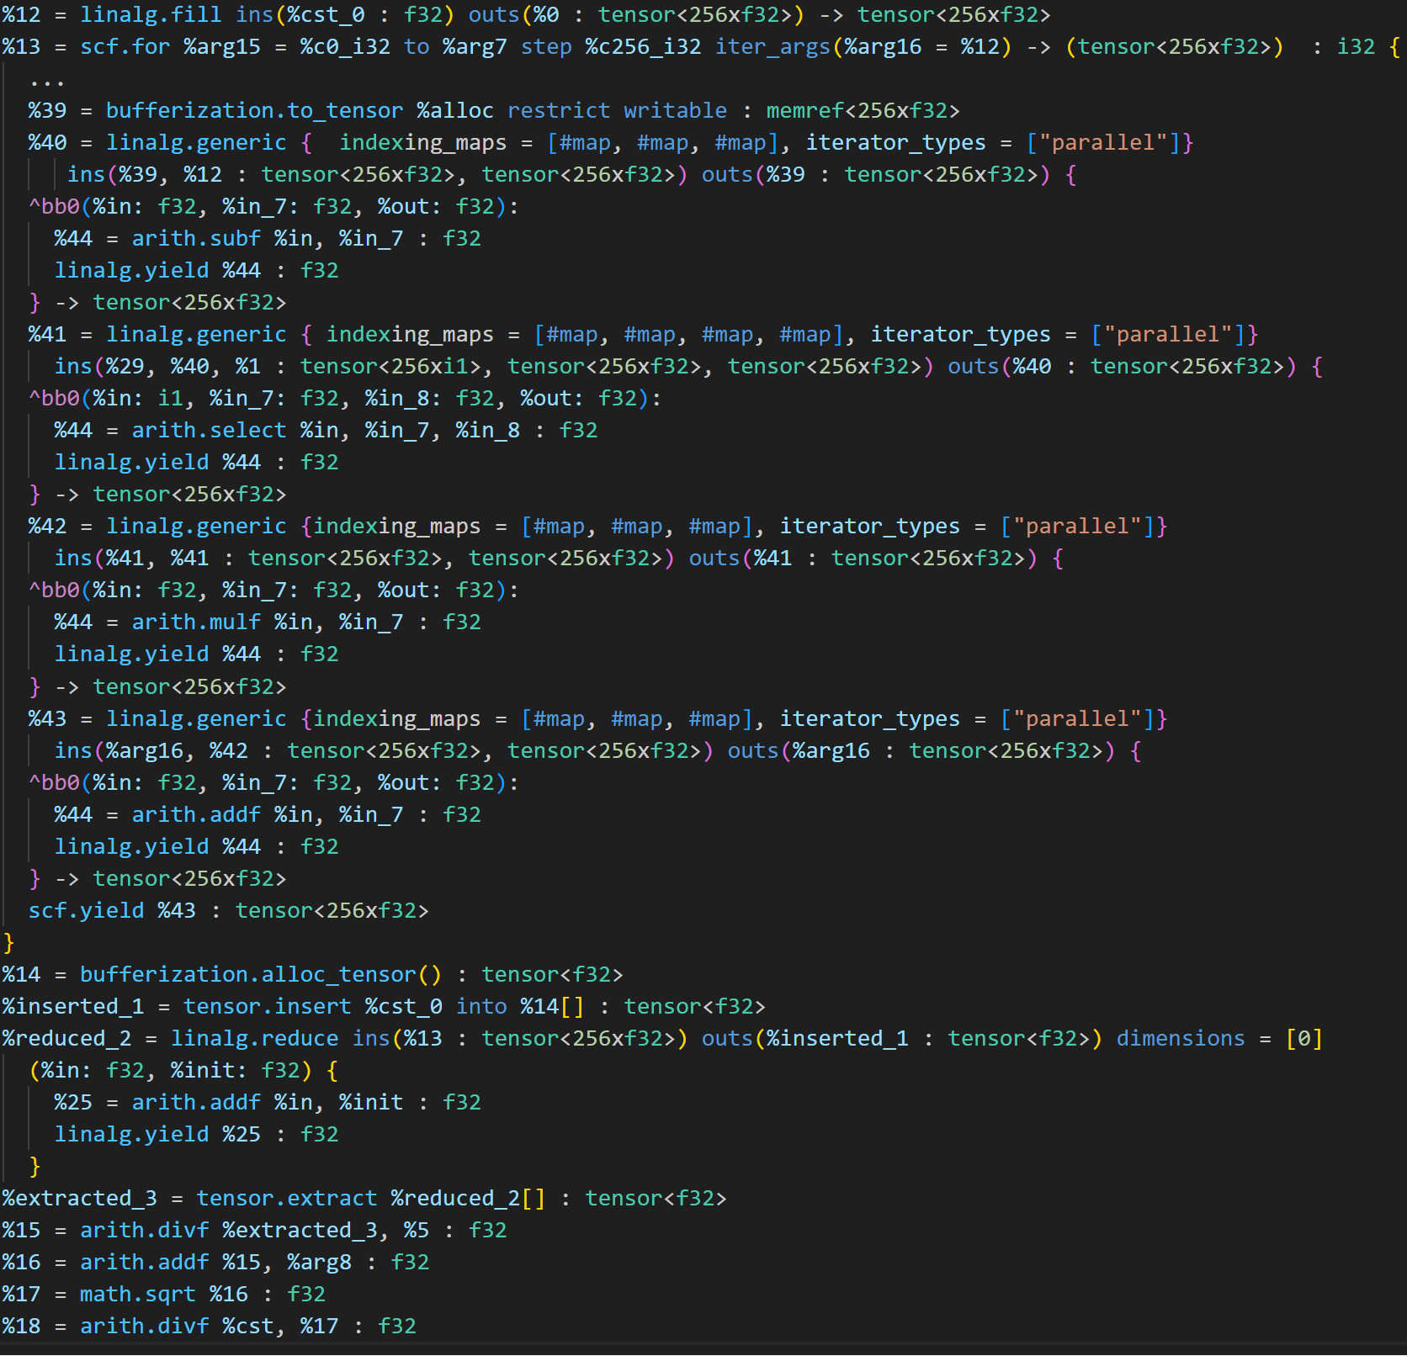
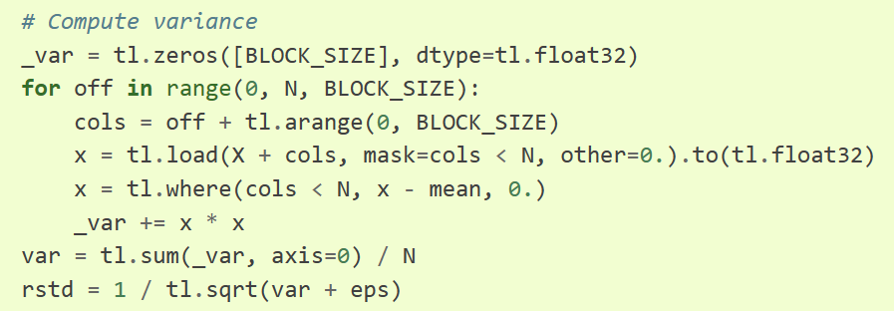
Layernorm
Notes:
Example from layernom

Slide 24
Triton to Triton-IR

Slide 25
Triton-IR to linalg
Notes:
Triton IR -> Linalg IR (tensors) + support IR
Track triton pointers using Pointer Analysis
Identify size, stride, and other metadata
BlockPointer makes this a lot easier ☺
Map triton load/store as pointer conversion from memref to tensor. Use the Pointer Analysis to build appropriate cast + subview

Slide 26
Triton as linalg
Notes:
Triton IR -> Linalg IR (tensors) + support IR
Track triton pointers using Pointer Analysis
Identify size, stride, and other metadata
BlockPointer makes this a lot easier ☺
Map triton load/store as pointer conversion from memref to tensor. Use the Pointer Analysis to build appropriate cast + subview

Slide 27

Triton as linalg
Notes:
Triton IR -> Linalg IR (tensors) + support IR
Track triton pointers using Pointer Analysis
Identify size, stride, and other metadata
BlockPointer makes this a lot easier ☺
Map triton load/store as pointer conversion from memref to tensor. Use the Pointer Analysis to build appropriate cast + subview

Slide 28
Triton as linalg
Notes:
Triton IR -> Linalg IR (tensors) + support IR
Track triton pointers using Pointer Analysis
Identify size, stride, and other metadata
BlockPointer makes this a lot easier ☺
Map triton load/store as pointer conversion from memref to tensor. Use the Pointer Analysis to build appropriate cast + subview

